Slide 1
Elder Mental Health Outreach Teams – EMHOTs August 31, 2022 Data Report Summary For 1-1-22 to 6-30-22 Reporting Period
Elder Mental Health Outreach Teams – Assess older adults for behavioral health issues, provide counseling and provide and/or connect elders to crucial social support services in their communities
There are Nine regional Elder Mental Health Outreach Teams, two new EMHOTs in Lowell and Dudley were launched in December of 2021. The now Nine EMHOTs currently cover 128 communities in Massachusetts, and are based in Amesbury, Bellingham, Boston, Dudley, Greenfield, Lowell, New Bedford, Pittsfield and Somerville/Cambridge.

Slide 2
Municipalities currently served by Elder Mental Health Outreach Teams
* Source: Lina Stoylar,
Senior Policy and Program Research Associate MAMH

Slide 3
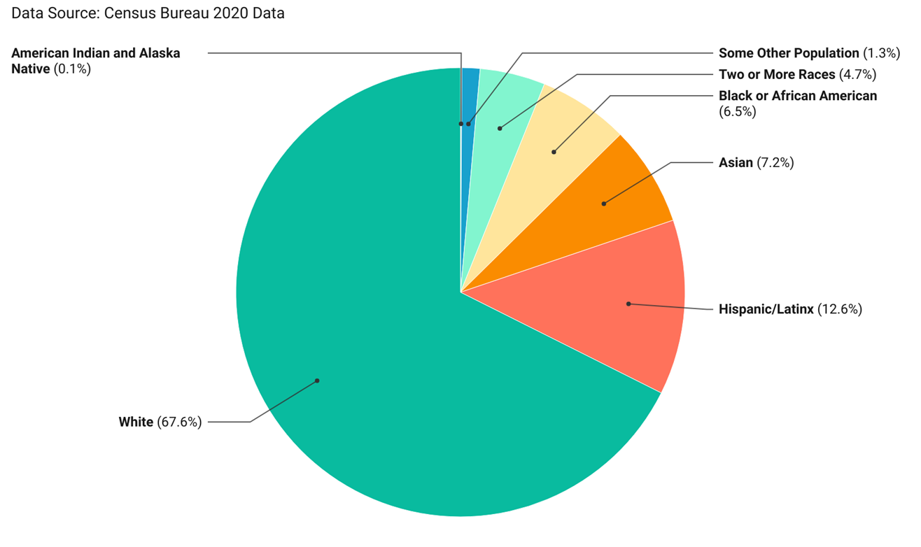
Racial and Ethnic Census Demographics (Adults in Massachusetts in 2020)
* Source: Lina Stoylar,
Senior Policy and Program Research Associate MAMH
Notes:
We took a deeper dive into the Race and Ethnicity Among EMHOT Consumers. On this slide is the Race and Ethnicity of Adults in Massachusetts based on the 2020 Massachusetts Population Data of Adults from the Census Bureau compiled online by UMass Donahue Institute

Slide 4
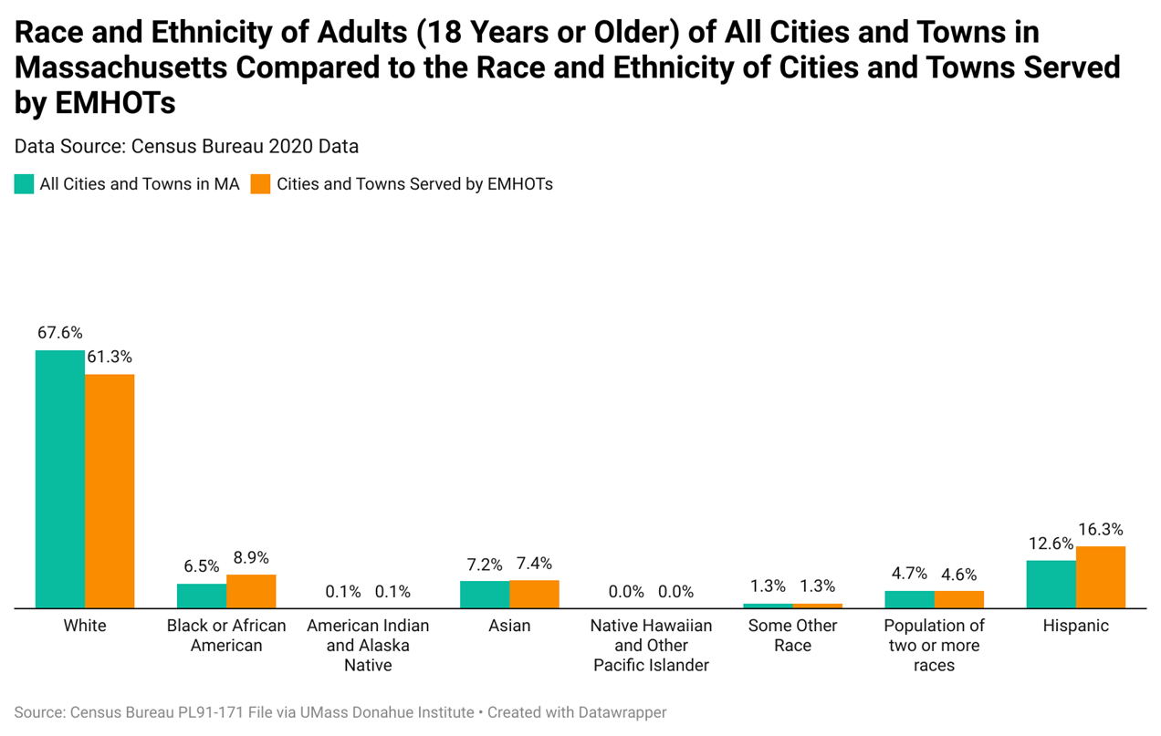
Cities and towns served by EMHOTs are slightly more diverse compared to MA overall
* Source: Lina Stoylar,
Senior Policy and Program Research Associate MAMH
Notes:
DATA SOURCES:
2020 Massachusetts Population Data Adults (18+) from the Census Bureau compiled online by UMass Donahue Institute

Slide 5
Race and Ethnicity of Adults in Cities and Towns served by EMHOTs in 2020, as compared to Race and Ethnicity of Older Adults served by EMHOTs in 2022
* Source: Lina Stoylar,
Senior Policy and Program Research Associate MAMH
Notes:
Next, we Compared the race and ethnicity of the cities/towns where EMHOTs services are provided, TO the race and ethnicity of the Older Adults who received EMHOT services in those cities/towns.
So as you can see the EMHOTs are serving diverse older adults,( *note Black/African American adults make up 8.9% of the population in those communities, and EMHOTs are reaching 6.7% of the 8.9%; EMHOT services need to expand to better serve the Asian and Hispanic older adults.
DATA SOURCES:
2020 Massachusetts Population Data Adults (18+) from the Census Bureau compiled online by UMass Donahue Institute
Data from the EMHOTs on older adults they served from January 1, 2022 to June 30, 2022.

Slide 6
Recent EMHOT findings Jan 1, 2022, to June 30, 2022 Number of Older Adults served: 596
Prior to the Pandemic, the 2018 Mass Healthy Aging Report¹ data showed 31.5 % of older adults in Massachusetts were diagnosed with depression.
Current EMHOT Data shows
The most common psychiatric conditions among EMHOT clients are
Depression (53% )
Anxiety (32%)
Dually Diagnosed with Substance Use (10%)
Current Risk Assessment and findings of EMHOT Clients
42% of EMHOT clients were found to be at Increased risk for experiencing significant health issues.
34% of EMHOT clients were found to be at Increased risk for decreasing ability to manage ADL’s (Activities of Daily Living, which include: Eating, Bathing, Dressing, Mobility and Toileting.)
19% of EMHOT clients experienced a behavioral health crisis in the reporting period.
19% of EMHOT clients were found to be at Increased risk for unstable housing.

Slide 7
Observations and Challenges During the Reporting Period of January1, 2022 to June 30, 2022
“COVID has increased hoarding behaviors. Decreasing isolation was important during this period - many participants wanted phone calls and visits…many clients find it hard to balance the need to not over-acquire with food insecurity. .” Source: Lowell EMHOT
“Despite the decrease in the number and severity of COVID cases, the number and severity of mental health concerns seems to have risen in the past 6 months. It appears this is in part due to clients who did not access care for over a year and consequently got sicker and in part due to a general decrease in availability to service providers. It seems advocating for a model which includes home based services for elders (much like we have for children in this state) would go a long way toward moderating the impact COVID had and continues to have on mental health.. ” Source: Bellingham EMHOT

Slide 8
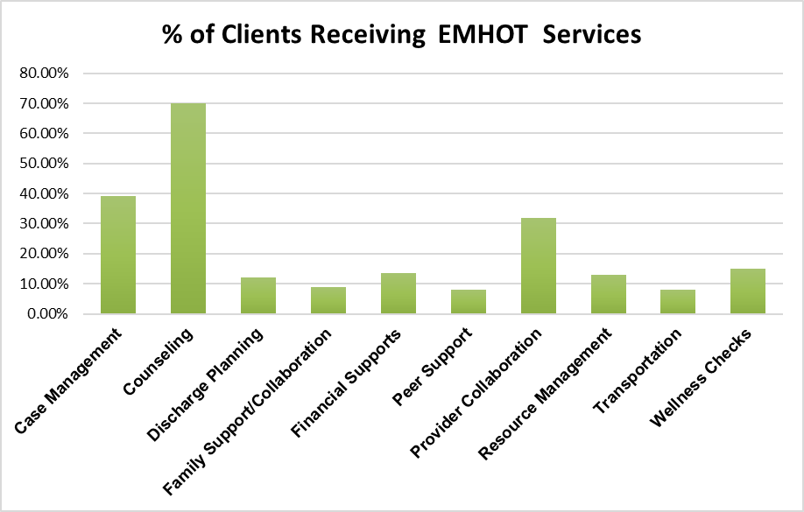
Services provided by EMHOT Programs
Case Management 38.09%
Counseling 70.03%
Discharge Planning 12.00%
Family Support-Collaboration 9.00%
Financial Supports 13.40%
Peer Support 8.00%
Provider Collaboration 31.88%
Resource Management* 13.00%
Transportation 8.00%
Wellness Checks 15.00%
4481 hours of counseling were provided directly by EMHOTs
* Resource Management includes arranging for and/or dropping off, food, medication, etc.

Slide 9
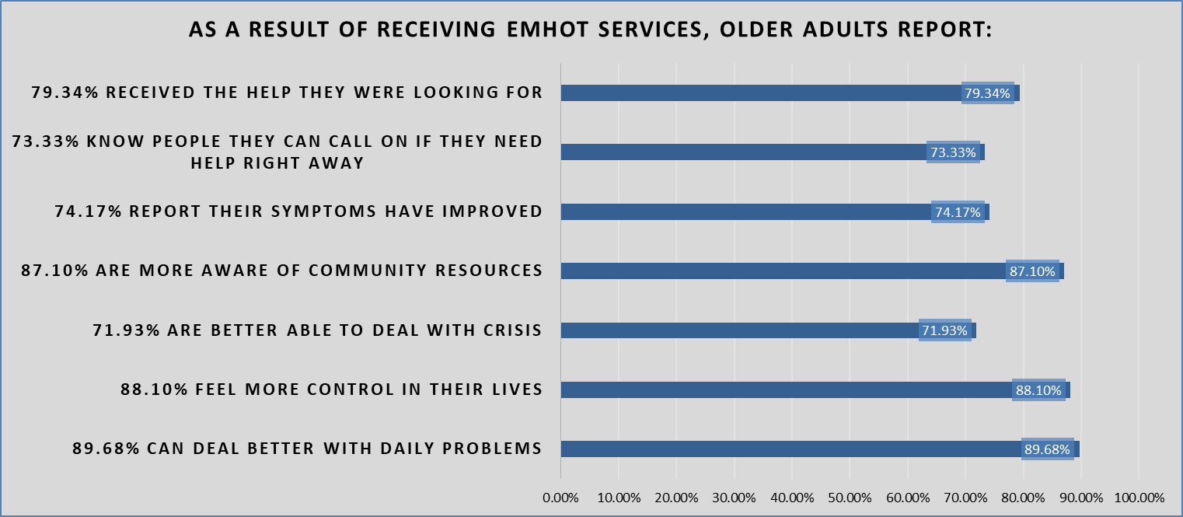
EMHOT Client Outcomes:
EMHOT Clients are asked to complete a brief survey concerning their experience with the EMHOT services they received over the last 6 months.

Slide 10
EMHOT Client Feedback
“Able to work on self care and decrease depressive episodes was most helpful to me .” New Bedford EMHOT Client
“The world we live in today it is very frightening for us elderly people. Many have no family and get most of their info through media TV etc. Most of which is negative and causes fear and depression and loneliness.” Bellingham EMHOT Client
“Being able to speak with a therapist every 2 weeks and getting medication prescribed by a nurse practitioner. -Talking about things helped me. -Knowing that there are resources” MVES EMHOT Client
“The social worker helped me to rationalize that there is no perfect family, but we have people who can help.” SCES EMHOT Client

Slide 11
Why EMHOT Programs work
EMHOTs provide the link to or directly provide behavioral health services, AND of vital importance is that EMHOTs are uniquely able to connect those elders to the additional community supports, resources and services that elders need to address the broader factors associated with behavioral health issues, such as chronic diseases, social isolation, housing insecurity, and financial challenges- this connectivity is why the work of the EMHOTs is successful.

Slide 12
How EMHOT Programs Save Money
Massachusetts has the highest rate of emergency room visits for behavioral issues in the nation². The economic burden of schizophrenia, bipolar disorder, and major depressive disorder in adults in Massachusetts is estimated to be at least $2.8 billion for each type of mental illness, and hospital costs range from $5,000-16,000 per stay for those admitted with mental illnesses such as Schizophrenia, Bipolar Disorder, and Major Depressive Disorder³
From 1-1-22 through 6-30-22, 113 cases referred to EMHOT programs were crisis cases.
If these 113 crisis case individuals were hospitalized due to lack of EMHOT services, the total economic impact would be between $565,000. to $1,808,000. (at $5,000 to $16,000 per admission- see next slide ). This is massive increase over the $1813. average per client cost of the EMHOTs for the 596 EMHOT clients who received services from 1-1-22 to 6-30-22.

Slide 13
Data Sources: Costs for emergency room visits for Behavioral Health Issues
Using national data, we extrapolated how much EMHOTS savings may impact the healthcare system and the Commonwealth. National data and trends on mental health/substance use disorders demonstrate the need for and cost effectiveness of EMHOTS. Currently one out of every eight emergency room visits involve mental health/substance use disorder⁴. The Healthcare Cost and Utilization Project reports nearly 41% of these visits result in hospitalization ⁵. Patients with mental health/substance use disorder are more than twice as likely to result in admission than patients without mental health or substance use disorder.⁵ Most emergency room visits for mental health/substance use disorder may be avoidable with appropriate outpatient care ⁶. There is no evidence that rates of mental health or substance use disorder have decreased since 2014, therefore the numbers proposed are conservative estimates of the cost / benefit analysis.
¹ http://mahealthyagingcollaborative.org/wp-content/uploads/2018/12/MA_Healthy_Aging_Highlights_2018.pdf
² Massachusetts Health Policy Commission, 2015 Cost Trends Report, Emergency Department Utilization (2016)
³ MacEwan JP, Seabury S, et al. Pharmaceutical innovation in the treatment of schizophrenia and mental disorders compared with other diseases. Innovations Clinical Neuroscience. Accessed August 27, 2020.
⁴ Trends in Emergency Department Visits Involving Mental and Substance Use Disorders, 2006-2013 #216 [Internet]. [cited 2020 August 27]. Available from: https://www.hcup-us.ahrq.gov/reports/statbriefs/sb216-Mental-Substance-Use-Disorder-ED-Visit-Trends.jsp?utm_source=AHRQ&utm_medium=EN-1&utm_term=&utm_content=1&utm_campaign=AHRQ_EN1_10_2017
⁵ Owens PL, Mutter R, Stocks C. Mental Health and Substance Abuse-Related Emergency Department Visits Among Adults, 2007. HCUP Statistical Brief #92. July 2010. U.S. Agency for Healthcare Research and Quality, Rockville, MD. http://www.hcup-us.ahrq.gov/reports/statbriefs/sb92.pdf. Accessed August 27, 2020
⁶ Trends in Emergency Department Visits, 2006-2014 #227 [Internet]. [Accessed August 27 2020]. Available from: https://www.hcup-us.ahrq.gov/reports/statbriefs/sb227-Emergency-Department-Visit-Trends.jsp

Slide 14
Acknowledgements
MCOA and its partners wish to thank Lina Stolyar, Senior Policy and Program Research Associate of the Massachusetts Association for Mental Health, for her data analysis contributions to this presentation.

